Slide 1

Toolkit Doc15 Fan Filter
May 5, 2010

Slide 2
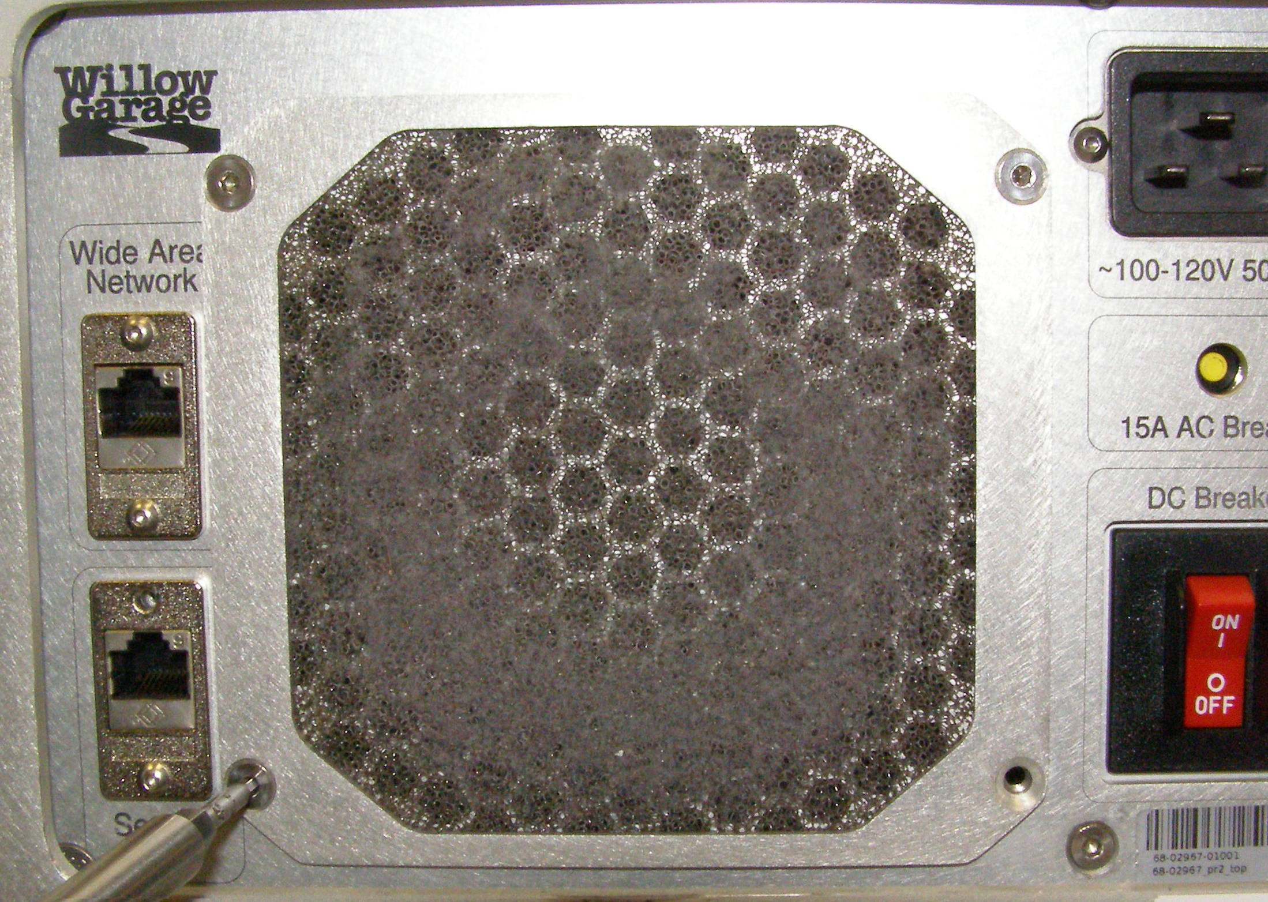
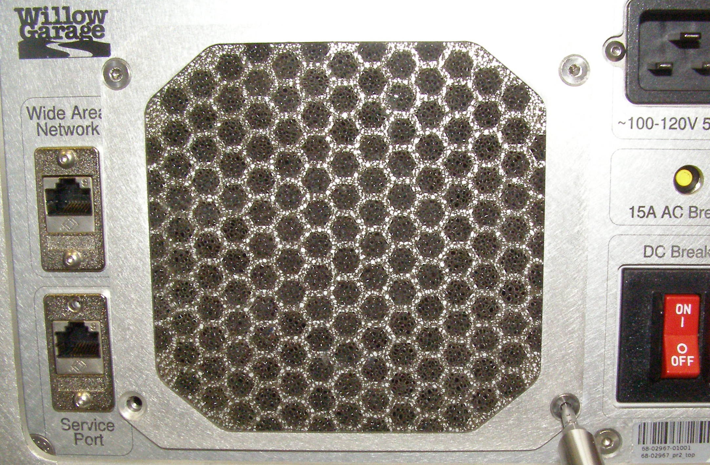
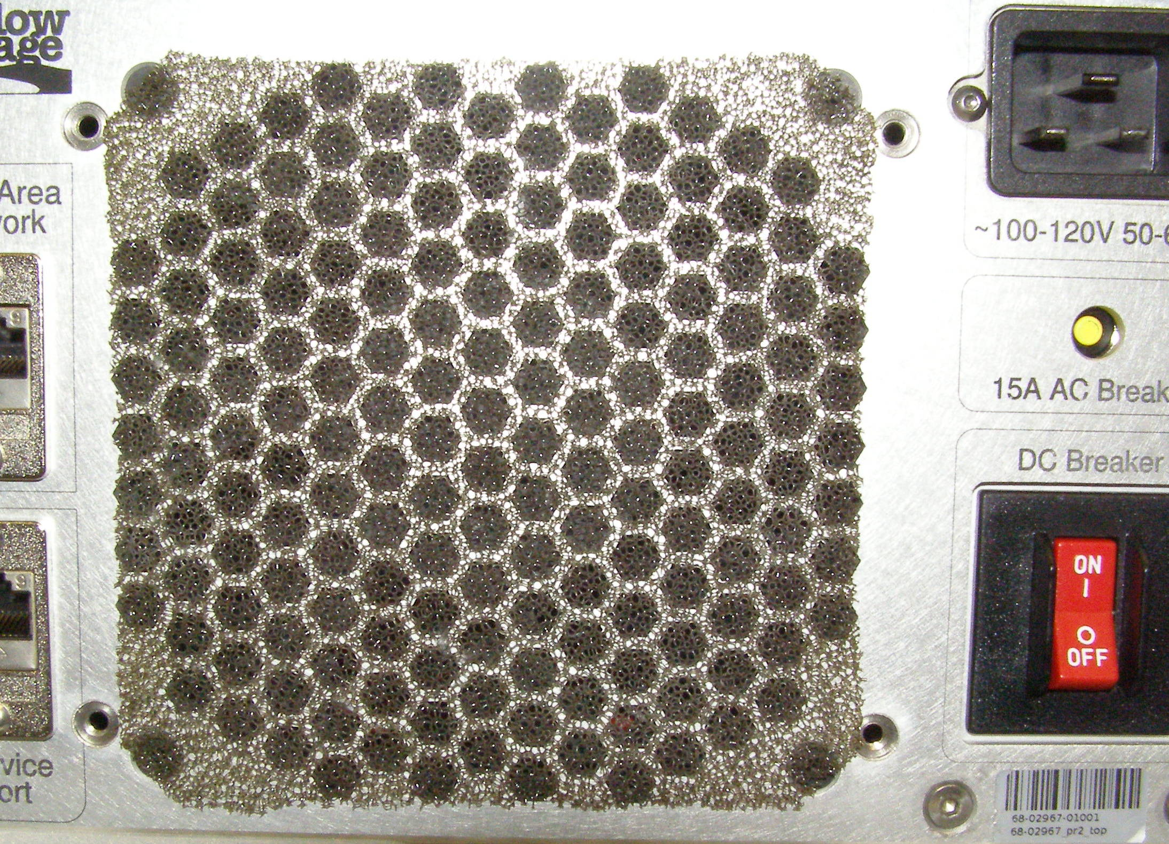
Fan filter R/R
Fan Filter – 2802, Plate – 2781, Removal
  Using the 2.5mm bit with the T-handle driver, remove 4 screw. 3064-06 (Fig 1)
  Clean the filter by blowing the dust out or washing it with soap and water. Make sure it is dry before installing.
  To expedite installation, turn on the robot so that the fan is running. The suction will hold the filter in place. Make sure it is centered.
  (Fig 2)
Plate, Install
  Reverse the removal procedure.
  Using Loctite 248, install the 4 screws and torque to 1.58Nm using the Large torque driver. (Fig 3)
Fig 1
Fig 3
Fig 2

